Slide 1

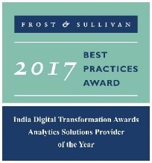


Scalable Data Platform – Operations Management
“ADVANCED ANALYTICS SERVICE PROVIDER”
2009-2016

Slide 2
Agenda
1
About LatentView
2
Technology Architecture Considerations
3
Representative case studies

Slide 3
1. About LatentView

Slide 4






LatentView at a glance
Founded in
Growing at an average of over
2006
Over
Work with
550
95+ %
30+
Princeton, San Jose, Chicago, Chennai, London, Singapore
People Strong
Fortune 500 Firms
YoY over last 5 years
Awards
Recognition
Member of
2009-2016
Customer council
Rated amongst the top
5%
4/5
10
Repeat business at
>85%
analytics companies to work for in India
Re-investment in Research and Development
top technology companies engage with us

Slide 5
















Who we work with

Slide 6
What we do?
We empower customers in their transformation journey by helping them move up the analytics maturity curve through actionable insights that leads to data-driven decisions that achieve business goals.
MATH
ACTIONABLE
DATA
INSIGHTS
BUSINESS
TECHNOLOGY
Notes:
LatentView’s propriety technology includes advanced analytics solutions designed to bring innovation to its customers’ digital transformation initiatives. These solutions support disruptive technologies such as artificial intelligence (AI) and machine learning, which are growing globally as companies seek deeper insights from their data and greater freedom for personnel to innovate.
LatentView works at the intersection of Business, Data, Math (Analytics / Quantitative Techniques) and Distributed Processing (Big Data) to produce actionable insights that helps answer business questions using an approach that is simple, pragmatic and effective. Quantitative Techniques cover the spectrum of Data Science and includes Machine Learning, Data Mining, Process Mining, Statistical Inference, Optimization, Business Process Simulations, Text Analytics, Data Visualization and other Cognitive technologies.

Slide 7













Why are we different?
Specialists in business-focused analytics
Single-minded focus to create strong impact on business metrics
33% of our people have a business degree
Experts in unconventional data sources and cloud-based data ecosystems
Partnership with Amazon AWS, and Microsoft Azure
Microsoft’s Gold Analytics Partner
Cutting edge customizable proprietary solutions and reusable frameworks
Panel Miner – A digital user-experience enhancer platform
TurfView – SEM optimization platform
Focus on Innovation and Thought Leadership
Institutionalized IdeaLabs for innovation and research
Partnership with IIT Madras to create IIT Data Labs
Notes:
Specialists in business-focused analytics:
Single minded focus to create strong impact on business metrics
Use cases:
For a Europe-based iconic automobile manufacturer, LatentView helped reduce warranty costs by 35%
For an American multinational technology giant, LatentView helped improve customer experience that resulted in potential monetization benefit between $3M to $18M annually
For a leading US-based beverages and snack manufacturer, LatentView identified demand spaces leading to a potential lift in sales in the range of 1.2-1.5X
For a leading baby food nutrition company, LatentView drove a 30% increase in web enrollment
2. 33% of our people have a business degree:
Top engineering + Business schools
1 month training program + LEAP – an extensive, skill-set based curriculum to bring them to industry standards
Well-planned career path that gives them global exposure; play a strategic role in the growth of the Fortune 500 companies they consult for
Experts in unconventional data sources and cloud-based data ecosystems
Partnership with Amazon AWS, and Microsoft Azure
Microsoft’s Gold Analytics Partner: LatentView has secured Microsoft Gold Partnership for Data Analytics. Microsoft Gold Partnership is the highest possible partnership in Microsoft Partner ecosystem.
Cutting edge customizable proprietary solutions and reusable frameworks
Panel Miner: Panel Miner is a cloud-based, fully-automated, data engineering, exploration, visualization and analytics solution for digital panel data built using Hadoop (MapR), RedShift (data warehouse), S3, Tableau and Python and JavaScript, orchestrated with data pipelines.
TurfView: TurfView is a solution which helps firms with a digital presence analyze the competitive landscape with respect to SEM and pricing at a granular level to strategize their online marketing strategy. It is a fully automated, scalable, cloud-based solution capable of scaling up to millions of queries across multiple sites, geographic locations and form factors.
Focus on Innovation and Thought Leadership
Institutionalized IdeaLabs for innovation and research: We typically reinvest close to 5% of our revenues into R&D. We have built a culture of innovation and R&D due to the nature of the industry we are in and our teams often deal with new technologies. While innovation has always been an integral part of LatentView’s culture, IdeaLabs (our in-house R&D center) was set up in early 2015 to adopt a more formal and structured approach to innovation. It aims to build market-ready analytics solutions in dynamic and emerging technology areas. It also builds on solutions created by delivery teams, to make them more comprehensive and world class.
Partnership with IIT Madras to create IIT Data Labs: In addition to IdeaLabs, LatentView has also established a data analytics lab in association with IIT Madras. The aim of this lab is to conduct advanced research programs and projects in data analytics. The data lab also develops thought leadership while advancing the capabilities of the entire industry.

Slide 8











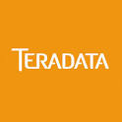


Data Ecosystem to Accelerate Analytics – LatentView’s Framework
LatentView leverages wide range of technology across the spectrum to deliver Customized Analytics Solutions
Business Strategy / Requirements
3
Enhance Intelligence
Understand Business & Data
Build multi-disciplinary team composed of data engineers, data scientists and business analysts
New Age Data Solutions
Analytics Components
Recommenders
Anomaly Detectors
Text Mining
Forecasting
2
Process Orchestration
Advanced Analytics Solutions like:
Early Warning System
Forecasting / Optimization
Next Best Offer
Customer Lifetime Value
Fraud Detection
1
Data Ecosystem
Harness data assets
Build Pipelines for supporting Core Analytics Components and Data Transfer processes from Source to Data Lake & Data Warehouse
Notes:
1) LatentView works across all 3 areas of - Harness data assets, Process Orchestration & Enhance Intelligence
2) Analytics is not done in isolation but is part of an enterprise ecosystem
3) Sophisticated analytical components are built taking advantage of technology developments (Ex: Distributed processing / Spark etc.), algorithm improvements (Deep Learning etc.) and hardware breakthroughs (GPUs)
4) Machine Learning algorithms are getting easier to use with Graphical User Interfaces (Ex: Microsoft Azure) and Curated One Click Modeling Techniques (Ex:BigML)
5) Increasingly Business Aware analytical solutions are being deployed in self-service mode
6) Creation of automated recipes for data pre-processing tasks like feature selection

Slide 9
2. Technology Architecture Considerations

Slide 10
Technology Architecture Considerations
In the new world, data architecture considerations remains the same, whereas the choices have evolved owing to the increase in Unstructured & Semi-structured data. LatentView helps the customer to evaluate the considerations and build a futuristic data ecosystem
Business Intent
How to get and store the data
How to make the data unambiguous
How to make use of data
Ingestion & Storage
Data Variety
Structured vs (Semi or) Unstructured
Normalized vs Relational vs Dimensional
Batch vs Streaming
Data Volume
Scalability & Performance
Archival & Retrieval
Reduction & Summarization
Transformation
Data Veracity
Consistency of business rules
Persistent data
Processing
Latency & Scalability
Processing Complexity
Information Delivery
Analytics Workloads
Canned reports
Self service BI
Data Discovery
Real time reporting
Advanced analytics
Intelligent Processes
Embedded Analytics
Optimized Rules & recommendations
Enablers
Process – Agile vs Waterfall vs Hybrid
Technology – platforms & applications
Cost – Capex & Opex
Deployment – Cloud, Managed Services, Traditional IT
Data Governance & Security
Future provisioning

Slide 11
Reference Architecture - Enterprise Analytics Platforms
Data Sources
Data Ingestion
Data management and analytics layer
Data Extraction
Information & Insight
Streaming
(Apps/ Servers)
Data Governance & Security
Predictive Dashboards
Governance
Application Metadata Management
Sensor Geospatial Time Series
(IoT / Sensors)
Batch Processing
Workflow and Co-ordination
Lexical Processing Engine
Machine Learning and Advanced analytics
Stream data processing
Distributed data processing Engine
Data Discovery and Search Engine
Intelligent Data bridge
Prescriptive Dashboards
Analytics
Structured
(RDBMS / CSV / TSV)
Real time Processing
What If Analysis
REST Services
Unstructured
(PDFs / Docs / Logs)
Real time Processing
Batch Processing
On Demand
JDBC
Reports
Data management
ODBC
Social
(Facebook / Twitter)
Data Quality
Applications
Enterprise Data Lake
A Ready Data Platform for Quick Realization of Analytical Solutions
Notes:
1) LatentView is helping organizations transform from a piece-meal, adhoc analytics approach to creating a comprehensive Enterprise Analytics Stack that provides all the capabilities required for producing repeatable, trustworthy, industrial strength analytics output.
2) The stack is modular in nature such that organizations can start small and add sophistication based on business demands and their maturity levels.
3) Enterprise Analytics Platform is completely business focused in that it incorporates all features required by business stakeholders:
a) Ability to experiment with new ideas, what-if analysis, scenario based simulations etc.
b) Decision validation loop that validates the analytical insights with real-word business outcomes

Slide 12



Technology Architecture aligned to the Digital Shift
Digital shift is accelerating across industries as there is an exponential increase in online transactions, social interactions and sensor based observations
Digital universe is doubling every two years with a 50-fold growth in the last decade. Companies that leverage the full power of this big data could increase their operating margins by as much as 60%
Cloud platforms are enabling new, complex business models and orchestrating more globally-based integration networks. Gartner predicts the worldwide public cloud services market will grow 18% in 2017 to $246.8B, up from $209.2B in 2016.
Scalable
Cloud
Human- and machine-generated data is experiencing an overall 10x faster growth rate than traditional business data, and machine data is increasing even more rapidly at 50x the growth rate.
IoT
Forbes Report, 2017
insideBIGDATA, 2017
Forbes Report, 2015

Slide 13

Technology Architecture - Cloud
CANNED REPORTS
Data Integration
Relational Data Store
(Ex: AWS Redshift)
Enterprise Reporting Platform
Structured
SELF SERVICE BI
Data Lake
(Example: S3)
Indexing and Querying
(Ex: Elastic Search)
Query Workbench & Custom dashboards
QUERIES
Unstructured
Other Data Sources
(Ex: Web Logs)
Machine Learning Workbench
ADVANCED ANALYTICS
Distributed Processing
Feature Engineering
Data Sampling
(Ex: Spark)
ETL Tools
Scripts
Event Listeners
Real time Indexing
(Ex: Elastic Cache)
REAL TIME REPORTING
Data Sources
Illustrative – Actual AWS based data infrastructure will be detailed during the first 2 weeks of the pilot

Slide 14

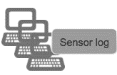



Real Time IoT Architecture and Stream Processing Framework
With the explosion of the IoT and the massive amount of data that will be collected, getting the data processed will be key which makes stream processing essential. To address this requirement, LatentView has developed a generic framework that will enable collection, integration, analysis and visualization of all this data in real-time..
SOURCES
NETWORK DATA
INCOMING MESSAGE QUEUE
STREAM PROCESSING
SEARCH INDEXING
DESTINATION
REAL TIME SEARCH & VISUALIZATION
APACHE KAFKA CLUSTER
ELASTIC SEARCH
SPARK STREAMING
Geolocation Data
Documents & Emails
REAL TIME MODEL TRANING
STATISTICS BASED ON TIME WINDOW
STORAGE
WebLogs & ClickStreams
SCALABLE HADOOP FILE SYSTEM
TRANSFORMING STREAMING DATA
REAL TIME SCORING
Social Networks
Machine Generated
OFFLINE BATCH ANALYTICS
APACHE SPARK
Sensor Data
Sample Usecases
Marketing Campaign Analysis: Continuously monitoring the effects that new campaigns have on the site traffic.
Smart Cities: Making Real-Time Transportation decisions with Data Visualization.
Fraud Detection: Scoring Credit card transactions real time to identify the fraudulent transactions.
HealthCare: Generating real time insights using data generated from Medical Device.

Slide 15



















Large Scale Data Architecture and Processing Frameworks
LatentView provides a flexible and a scalable framework for Analytics on Machine generated data. This offering can be customized for a wide range of usecases and can be deployed as either a standalone system or can be integrated with customer’s existing IT systems.
Data Collection
Data Storage
Data Analysis
Data Visualization
Bulk Data Load
ETL Process
Message Bus/Queue
Streaming Data Collection
O LTP Database
OLAP Datawarehouse
NoSQL Database
Distributed Datastore
Machine Learning
Search Engine
Real Time Event Processing
Unstructured Data Mining
Web Services
Web Dashboards
Weekly Reports
Alerting
Latentview Capabilities-Highlights
In house Parallel Computing Hadoop like framework developed for processing & scraping data from 700,000 HTML pages in less than 24 hours
Ingesting sensor data over the network into message bus.
Automated data pipeline built to periodically collect data from teradata, process and store in MongoDB
Experience in creating data models and querying from various relational & non- relational databases.
Inhouse tools built using best of breed technologies like Mahout & Hadoop
Benchmarking & POV exercises conducted for latest technologies like revolution R, MlDB, H2O
Air Quality Dashboard , Social Media Dashboard conducted using Spark Streaming frameworks.
Single Page application for a matchmaker solution for customers of a client with data centers worldwide.
Visualization developed for a patent-filed causality framework
Client sponsored Data visualization hackathons conducted

Slide 16
3. Representative Case Studies

Slide 17
1. Cloud based data lake to enhance Analytics Operations

Slide 18

Cloud based data lake to enhance Analytics Operations
The Data Repository solved a number of problems faced by Sysco
Delays in accessing and analysing data
Always Open Repository
Legacy Ageing Business Analytics Infrastructure
Modern State of the Art Data Store
Data Discovery is Difficult
Discoverable Data Sets for end users
Difficult to Handle Large Volumes of Data for Analytics
PySpark + S3
Constraints due to Total Cost of Storage
Optimized Data Storage – Parquet, Gzip, etc.

Slide 19

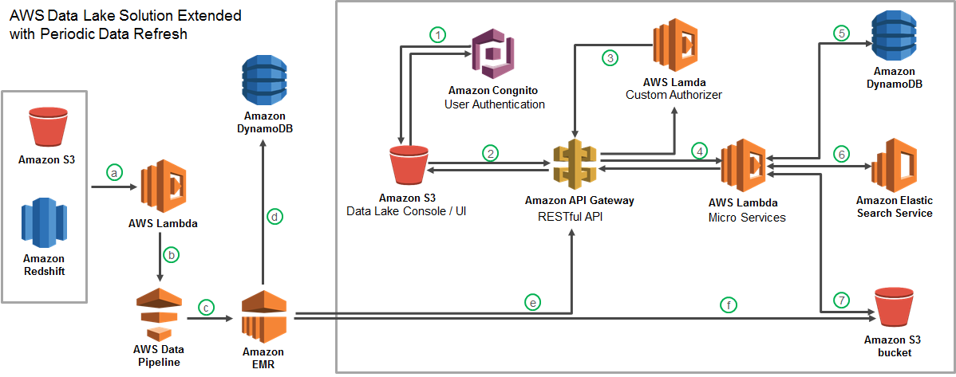



Cloud based data lake to enhance Analytics Operations
Largest Food Distributor in the US
The Problem: Ageing legacy Business Analytics Infrastructure with high cost of ownership slowing down realizable analytics value
The “Before” State
LatentView Solution
The “After” State
Business users faced significant delays in accessing and analyzing data and had difficulty in handling large volumes of data for analytics
Migrated 60TB of data from legacy systems into a cloud based data lake with extended periodic data refresh which supports reporting and advanced analytics solutions
Reduced cost of ownership and increased throughput of cloud hosted analytics solutions
Recommendation Engine
Order Anomaly Detection
Product Substitution
Revenue Management Use Cases

Slide 20
2. Improving Service Delivery by granular forecasting and inventory optimization

Slide 21
Improving Service Delivery by granular forecasting and inventory optimization
Repair Vs. Replace
Competition
Customer Experience
Complete 95% of service requests within 5 days
Goal
Complete 95% of service requests in 5 days
Business Process
Sales & Operations framework
Workforce Planning
Inventory Planning
Supply Allocation
High variance between forecasted demand and actuals
Delay in tech allocation and scheduling
Replacement Parts not available
Align marketing to supply
Identify Service Drivers
More granular forecasting to match supply
Optimize tech allocation for granular demand
Optimize truck stock and order – tech – part match
Reallocation of supply in response to gap/surplus
Analytics Powered Solutions
Accuracy up to 92% from 65% reducing lead time by 20%
USD 5 million per annum in incremental revenue as a result of reduced cancellations
10% reduction in reschedules, resulting in lower trips per repair
Enabled identification of US$300,000 opportunities every year
Impact

Slide 22
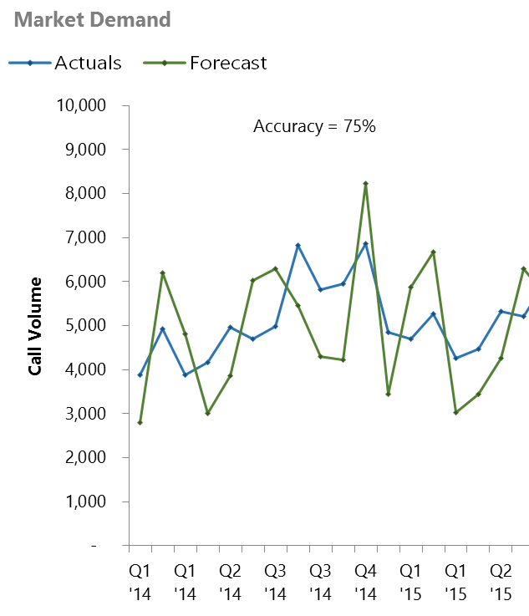





Supply Chain : Sales & Operations Planning Framework
BOTTLENECKS
SOLUTION
IMPACT
Bottlenecks in previous state
We identified a lack of maturity in the S&OP process in terms of processes, data, and tools to more effectively plan demand.
Low segment accuracy: Lack of visibility into downstream usage of data, cannot capture change in demand across markets
Incompatible demand planning and forecast process: Forecast generated cannot be directly compared with the planned demand
Rudimentary planning process: No periodic updates to the process or exception alerts to mitigate outliers
No Single plan number: Each function operates with a different view of demand plan

Slide 23



Supply Chain : Sales & Operations Planning Framework
BOTTLENECKS
SOLUTION
IMPACT
Solution Framework
Use External data such as holidays and weather forecast to more accurately capture variations in demand and deliver for 40K+ segments
1
2
Data gathering & business inputs
Baseline forecast
generation
Measure accuracy, Improve Model
4
Finalize forecast and Demand plan
3
Executive review and Consensus demand
Methodology
Combine forecasts from different algorithms to boost the accuracy ARIMA, ETS, TBATS or Holt-Winters
Determine if the time series requires any additional transformations
Treatment of missing Values
Outlier Treatment
Feature Engineering
Data Transformation
Choose the model with best accuracy fit
Accuracy (WAPE) calculated at the end of each monthly cadence ; flag poorly performing segments for improvement

Slide 24
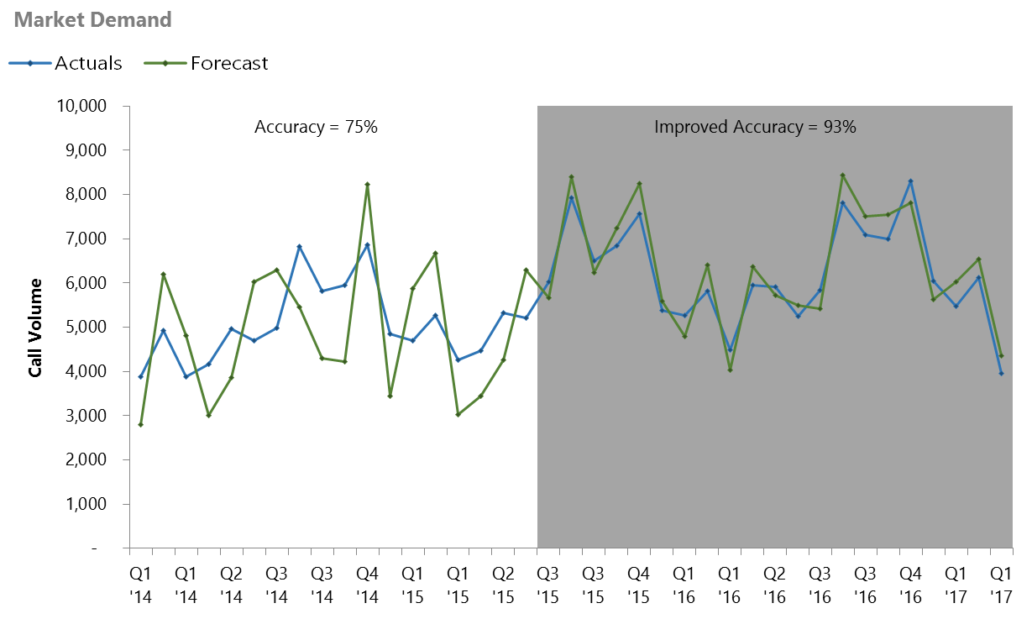


Supply Chain : Sales & Operations Planning Framework
BOTTLENECKS
SOLUTION
IMPACT
Impact
Accurate forecasts
Improved overall Demand Forecast Accuracy from 65% to 92%; Most granular levels accuracy at 84%
Lead time to customer
Reduced lead times by 20% to the consumer, improving overall service levels

Slide 25




Supply Chain : Supply Planning & Optimization
Workforce Optimization
Business Impact
Project supply based on Efficiency factors of techs, expected demand and availability of service technicians
Capacity Metrics
Identify Gap/Surplus between demand and optimized capacity at each market segment level
Reduce Idle Capacity and Ensuring minimal gaps in high Demand geographies
Insights & Reporting through web tool and enable Analysts to provide commitments to meet Weekly Demand
US $5 million per annum in incremental revenue as a result of reduced cancellations
Full Time Equivalents
Model Inputs to Optimizer
Availability of Technician
Time taken to complete
Case load
Overall Capacity
Tech Efficiency
Tech Avaliablity Period
Optimize Supply
Analyze technician availability and historical cycle times to build the overall Capacity
Tech Skills
Run a Quadratic optimization model using Solver in Python to minimize Gap/Surplus and Optimize workforce supply

Slide 26


Supply Chain : Inventory Planning
Truck Stock Optimization
Business Impact
Ensure that the right technician with the right parts in service van is dispatched in the first attempt to service a request
Servicing Profitablity Metrics
Develop an integrated service technician profile and parts planning process based on analysis
Establish planning geographies as foundation for profile and parts planning methodology
Optimize truck stock assortment process
Reduce cost involving multiple attempts on a service request
4% Increase in First Time Completes
Identify Key variables for model
Margin
Expected number of first time fixes
No. of requests assigned
Recalls and Reschedules Rate
Expected Profit Generation
Data Mining & Model Building
First Time Completes Rate
Model Validation & Refresh
Output
Assortment of Part level information to be carried in each truck for achieving first time fixes subject to maximized profit

Slide 27

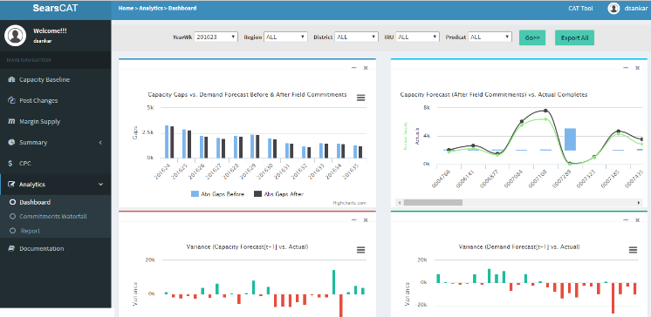
Supply Chain : Dynamic Capacity Reallocation
Enable Reallocation of Capacity on changing Demand
Business Impact
Identify Gap/Surplus between demand and optimized capacity at each market segment level and help plan by Reducing Idle Capacity and Ensuring minimal gaps in high Demand geographies
Internal Data
Enabled identification of opportunities worth an additional US$300,000 every year
The annual savings in capacity management were increased by US $ 25,000 every year.
Provide insights on metrics like Response Time, Trips per Repair, Gap/Surplus at each market segment
Demand Forecast
Data warehousing
ETL process setup to
synchronize
Response Time
Develop & Maintain the analytics interface
Overall Capacity
Gaps/Surplus
Operational LP analytics and Validation
Setup & maintain a data mart in SQL server
Recommended Actions
Identify Gap/Surplus between demand and optimized capacity at each market segment level

Slide 28
Appendix

Slide 29


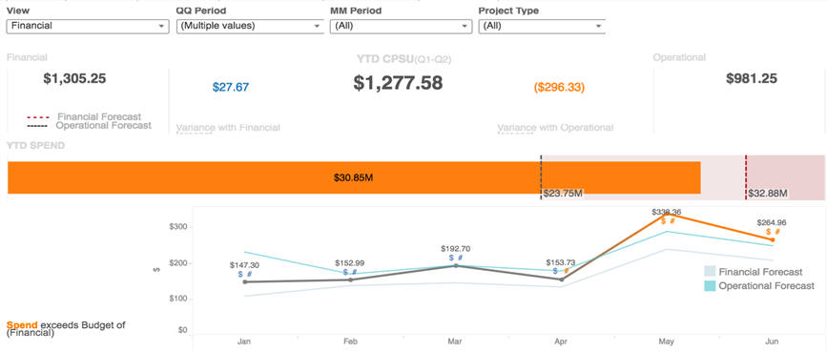





Asset Optimization to Reduce IT Logistics Cost
World’s Largest Social Media Company
The Problem:
In large knowledge driven companies, Information Technology related costs can be a significant % of operating expenses
The “Before” State
LatentView Solution
The “After” State
Demand & Supply for desktops and laptops was based on rudimentary planning data which resulted in significantly higher IT logistics cost than expected
Optimized IT logistics cost by forecasting employee turnover using time series forecasting and by predicting asset upgrades and failures using Asset Survival Models
Implementing the solution saved the client
$6 million for fiscal year 2016-17.
Forecasting Headcounts and Attritions
Spend Tracking and Scenario Planning
Demand Forecasting
Employee Headcount
Employee Inflow and Outflow
Net Optimized buy
/ Cost per Served User
Asset Loss
Asset Upgrades
Predicting Asset Failures and Upgrades
Supply Forecasting
Asset Availability
Safety Stock
Asset Failure
29
Notes:
Facebook IT-Logistics
Business Objective: Lack of data based forecasting for demand and supply drivers resulting in high cost for IT logistics.
LatentView Solution:
Calculate the Cost per Served User Estimation by
Budgetary Planning
Monthly Forecasting
Operational Management

Slide 30
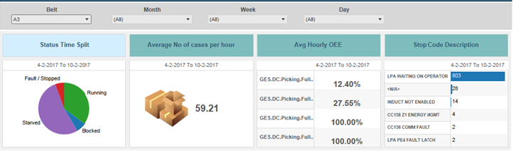
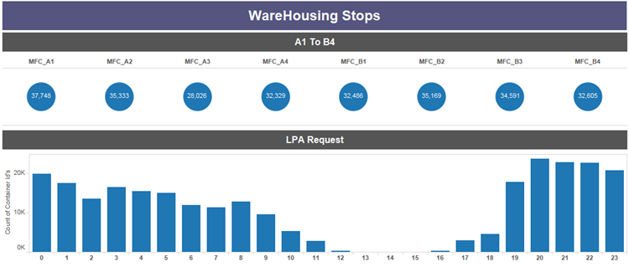
Process Mining to Improve Manufacturing Throughput
Key Digital Trends in the Auto Industry
The Problem: Difficulty in identifying bottlenecks in high throughput assembly lines as the process is non-linear in nature.
The “Before” State
LatentView Solution
The “After” State
Cases processed per hour were at a very low value of ~400 / hr as against the expected target of 800 / hr and the root cause of the problem was not known.
Utilized Process Mining to identify bottlenecks like:
18% of cases stuck at carton sorted area
20% of cases diverted back to carton sorted area from the aisle lift pickup as they arrived at wrong aisle
Cases processed increased to 680/hr./ door
Inventory levels reduced from 48 to 45 days
Savings of $1 MN per packaging line
KPIs for LPA, PickBelt, PickAcc & Distmerge:
No. of cases processed on a hourly basis:
Notes:
Pepsico – Warehousing Stops
Business Objective:
Understand the reason why LPA falls short of expected target of 800 cases/hr./ door
Develop a dashboard to identify and compare the scenarios of LPA performance
LV Solution:
Identification of processes around LPA which might have a significant impact on LPA performance
Use Disco (Process Mining tool) to find the bottle necks in the warehouse process
Pick Belt not sending enough cases to Pick Acc.
Pick account is unable to process that many cases in time
Speed of LPA is reduced since distribution merge is at its full capacity (unable to take anymore cases)
Findings:
18% percent of cases are stuck at carton sorted area since its not able to map them to the exact aisle lift pickup area
20% percent of cases are being diverted back to carton sorted from the aisle lift pickup as they arrived at wrong aisle
Business Benefits:
Cases processed increased to 680/hr./ door
Inventory levels reduced from 48 to 45 days
Savings of $1 MN per packaging line

Slide 31

Thank You!

